Slide 1

Binary logic and arithmetic
Əsmər, Qumru, Namiq

Slide 2
WHAT IS THE BINARY LOGIC?
Binary logic consists of binary variables and logical operations. The variables are designated by the alphabets such as A, B, C, x, y, z, etc., with each variable having only two distinct values: 1 and 0. There are three basic logic operations: AND, OR, and NOT.
What are the basic digital logic gates?
The three basic logic gates are:
AND OR NOT

Slide 3
AND, OR, and NOT:
AND
OR
(sometimes called “intersection” and indicated by the symbol • or ∗) means that, given two statements X and Y, if both are true, then X • Y = 1. If either one is false, then X • Y = 0. For example, the statement “It is raining (X) and the sun is out (Y)” is true only if both it is raining and the sun is out.
(sometimes called “union” and indicated by the symbol + ) the inclusive “or” means that, given two statements X and Y, if either one or both are true, then X + Y = 1, while only if both are false is X + Y = 0. For example, the statement “It is raining (X) or the sun is out (Y)” is true in all cases except when both are not true.

Slide 4
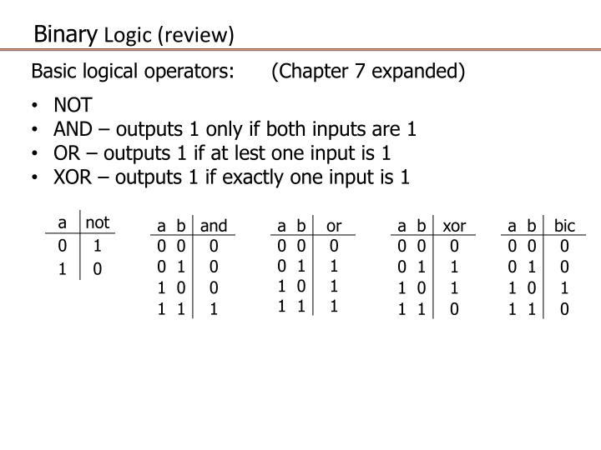
NOT
(sometimes called “negation” and indicated here by the postsymbol ′ as in X′, but sometimes indicated in other texts with an overbar as in ) is an operation performed on a single statement. If X is the variable representing that single statement, then X′ = 0 if X = 1, and X′ = 1 if X = 0. Therefore, if X is the variable representing the statement “It is raining,” then X ′ is the variable representing the statement “It is not raining.”

Slide 5
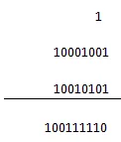
WHAT ARE BINARY ARITHMETIC OPERATIONS?
Binary arithmetic operation starts from the least significant bit i.e. from the rightmost side.
Binary Addition
There are four steps in binary addition, they are written below
0 + 0 = 0
0 + 1 = 1
1 + 0 = 1
1 + 1 = 0 (carry 1 to the next significant bit)
An example will help us to understand the addition process. Let us take two binary numbers 10001001 and 10010101
Binary Arithmetic
The above example of binary arithmetic clearly explains the binary addition operation, the carried 1 is shown on the upper side of the operands.

Slide 6

Binary Subtraction
Binary Subtraction
Here are too four simple steps to keep in memory
0 – 0 = 0
0 – 1 = 1, borrow 1 from the next more significant bit
1 – 0 = 1
1 – 1 = 0
A binary arithmetic example is given to understand the operation more clearly
The operation shows the binary subtraction clearly.

Slide 7

Binary Multiplication
Binary multiplication may sound like it would be more difficult than binary addition or subtraction – but is actually a simple process. Here are the four steps to be followed, using the same binary numbers 10001001 and 10010101:
0×0=0
1×0=0
0×1=0
1×1=1 (there is no carry or borrow for this)

Slide 8
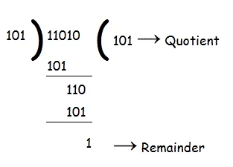
Binary Division
Binary division is comprised of other two binary arithmetic operations, multiplication and subtraction; an example will explain the operation more easily.
Here 101 is the quotient and 1 is the remainder.

